Slide 1

Smart Healthcare Appointment and Resource Management System
SRAVAN KUMAR REDDY PERUGU

Slide 2
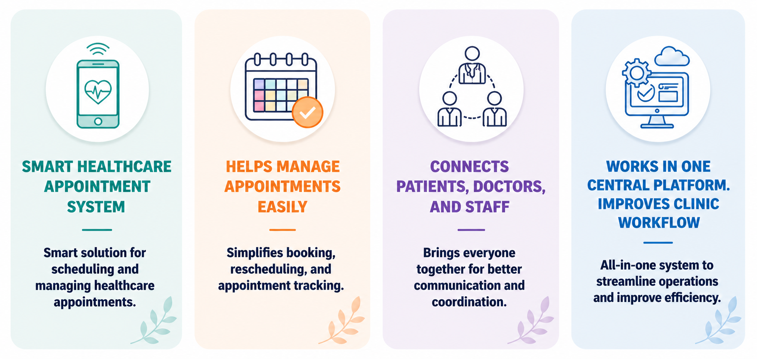
INTRODUCTION

Slide 3
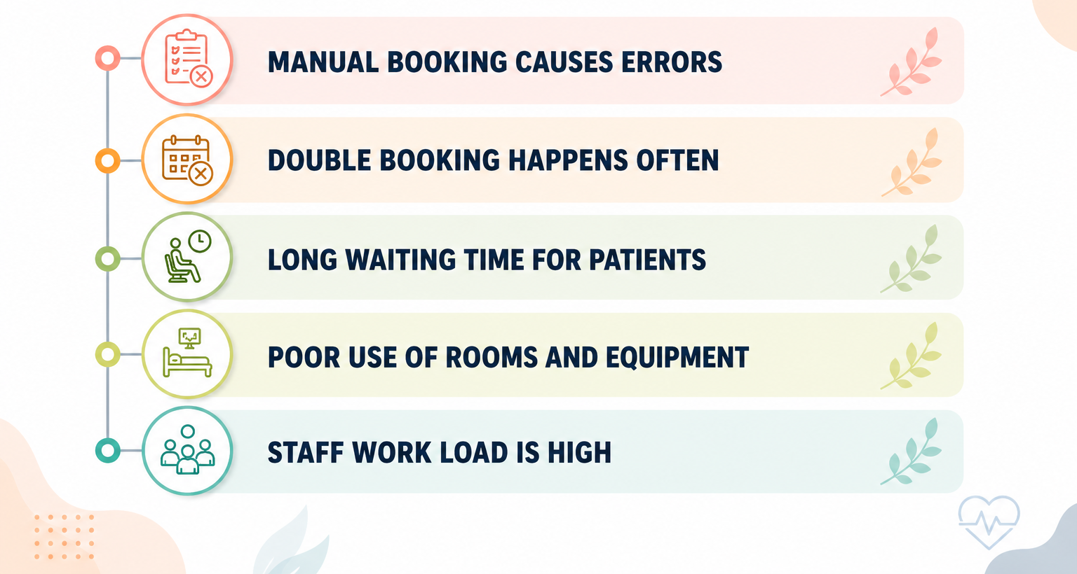
CURRENT PROBLEMS

Slide 4
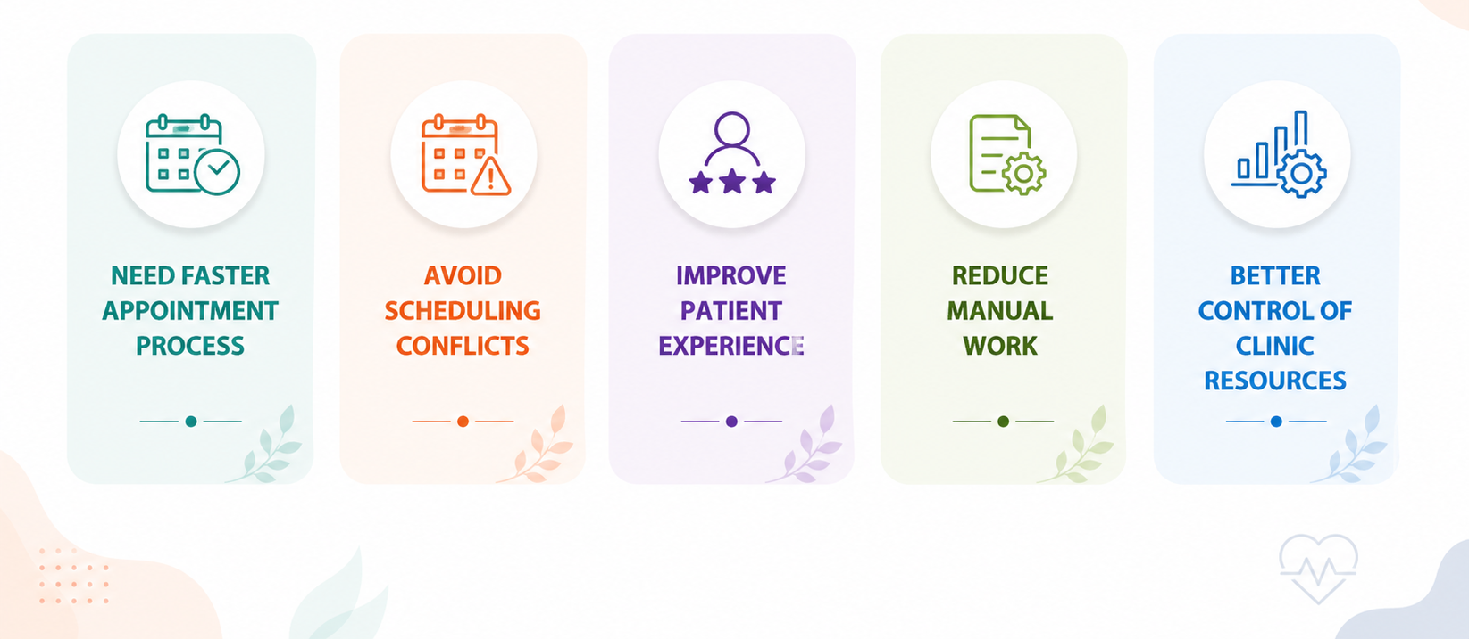
WHY THIS SYSTEM ??

Slide 5
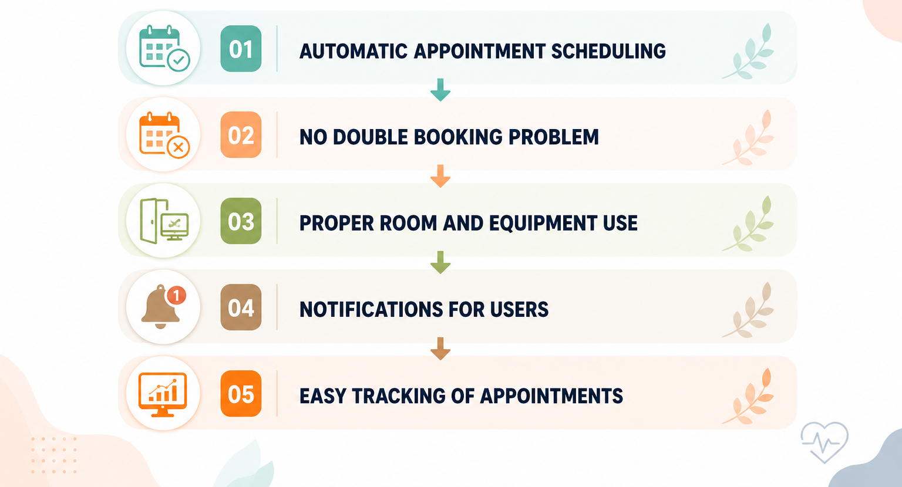
SYSTEM BENEFITS & SOLUTIONS

Slide 6
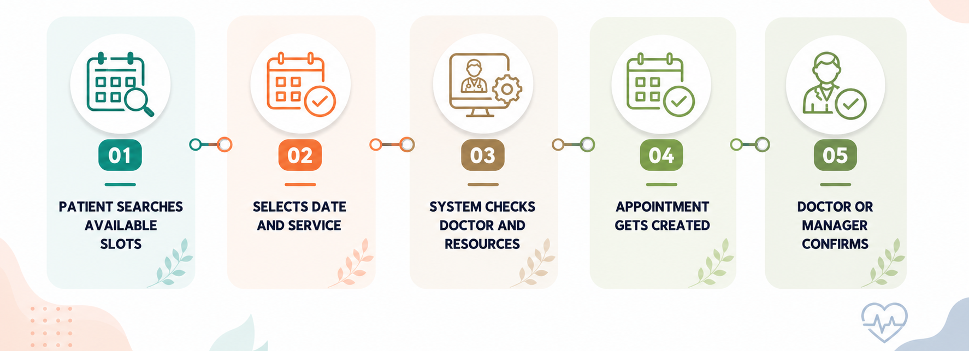
SYSTEM WORKFLOW

Slide 7
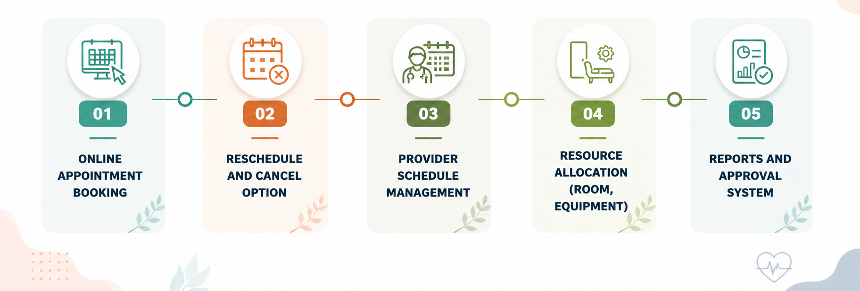
MAIN FEATURES

Slide 8
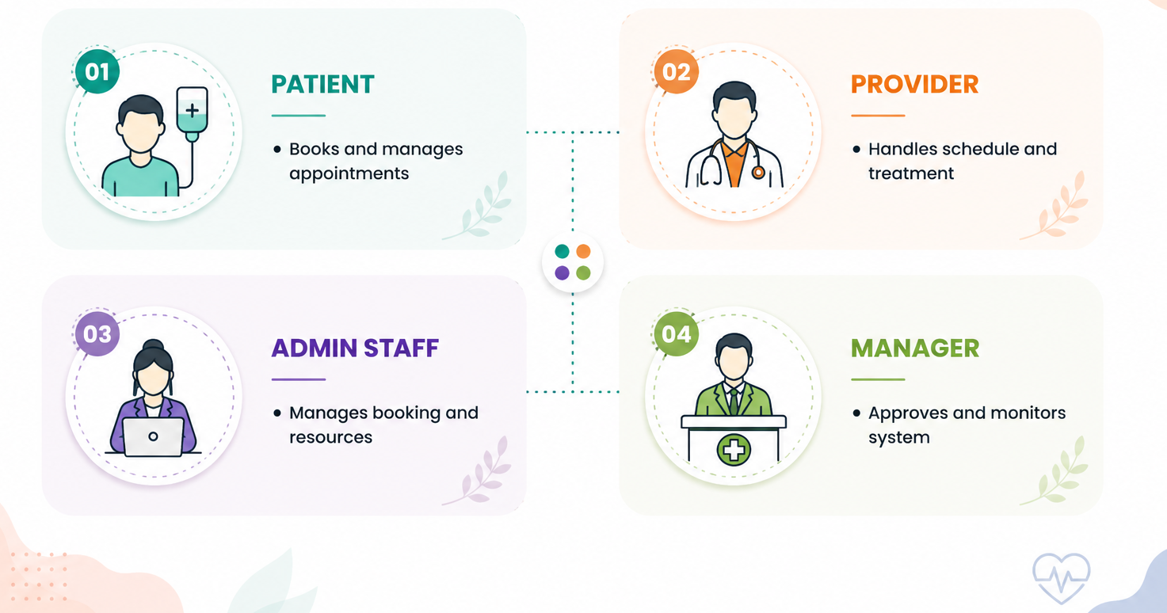
KEY ACTORS

Slide 9
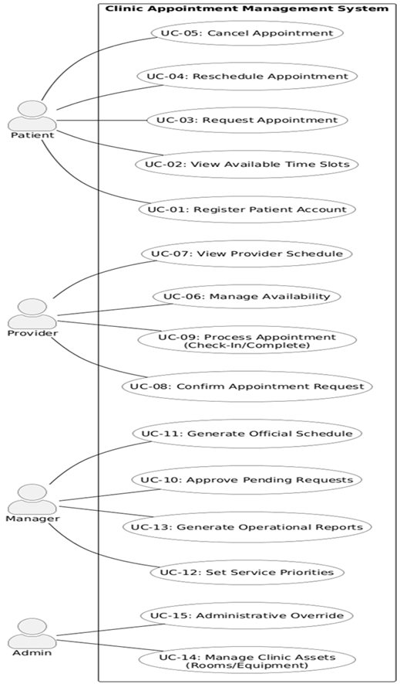
USE CASE DIAGRAM
My system’s use case diagram shows 4 main actors: Patient, Provider, Manager, Admin
Patient handles booking, reschedule, cancel, view slots
Provider manages availability, confirms and completes appointments
Manager handles approvals, schedules, and reports
Admin controls system setup, resources, and overrides

Slide 10
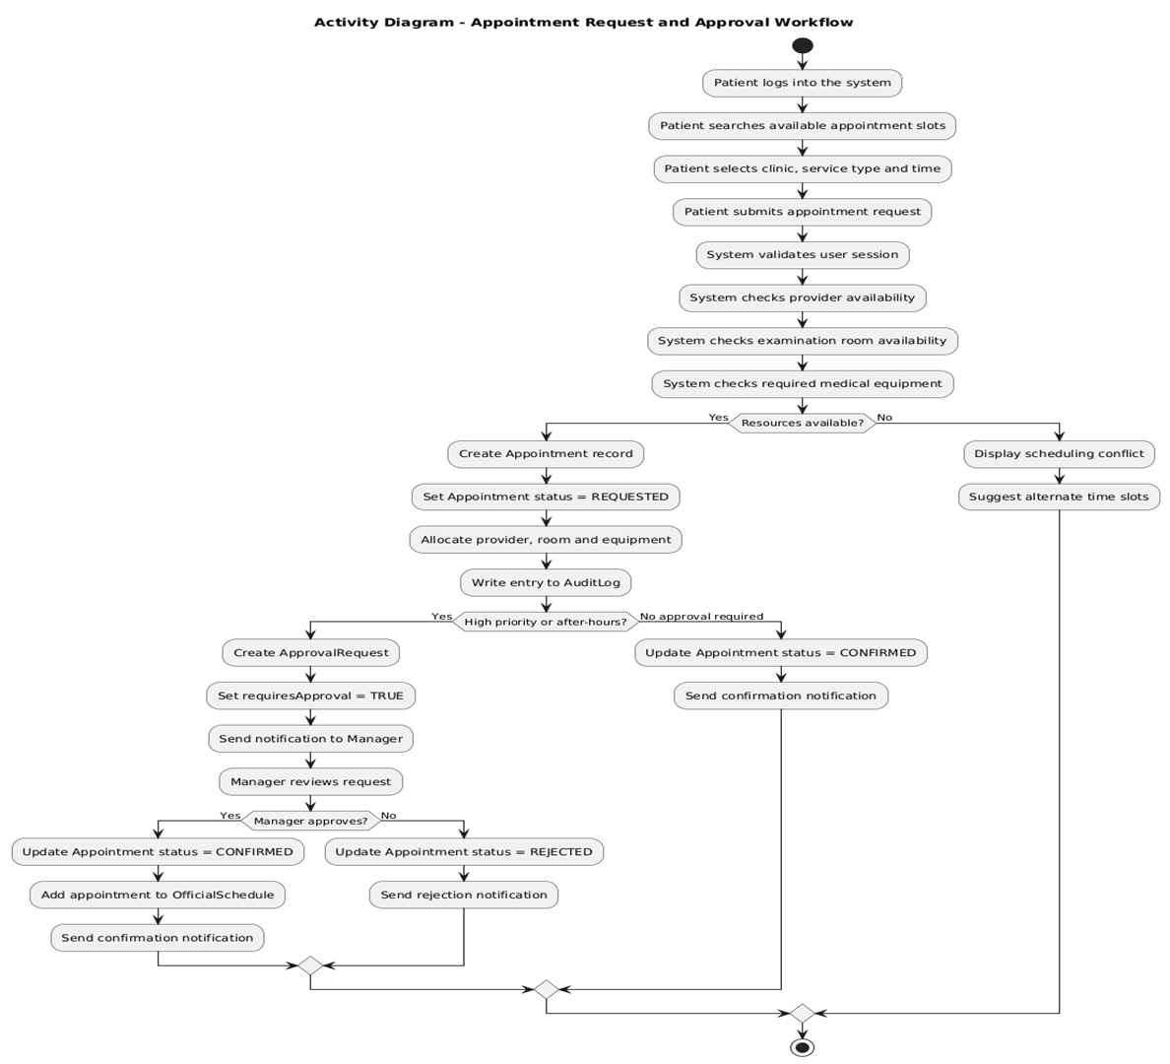
ACTIVITY DIAGRAM
This activity diagram explains how my system handles appointment flow
Patient checks slots and sends request, system verifies availability
System processes booking based on resources and conditions
Manager step comes only for special or high priority cases
Final result shows confirm, reject, or suggest another slot

Slide 11
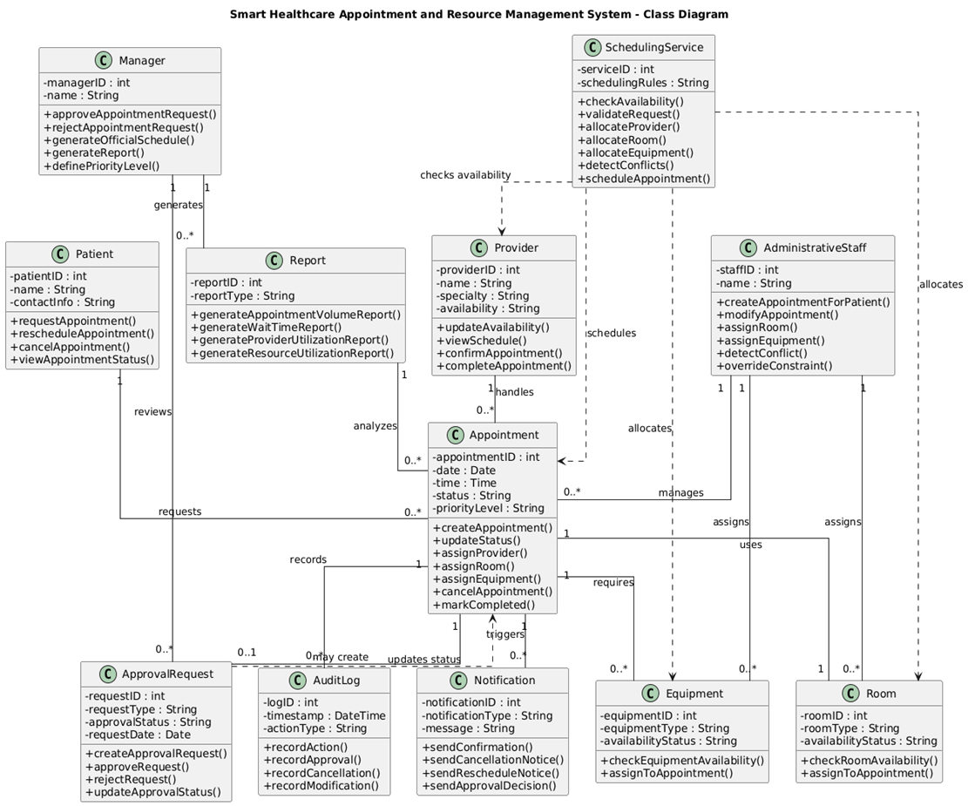
CLASS DIAGRAM
This diagram shows how my system is structured
Appointment is the main part, everything connects to it
Scheduling service handles all booking logic
Each role has its own job in the system
Other parts help with alerts and tracking system work

Slide 12
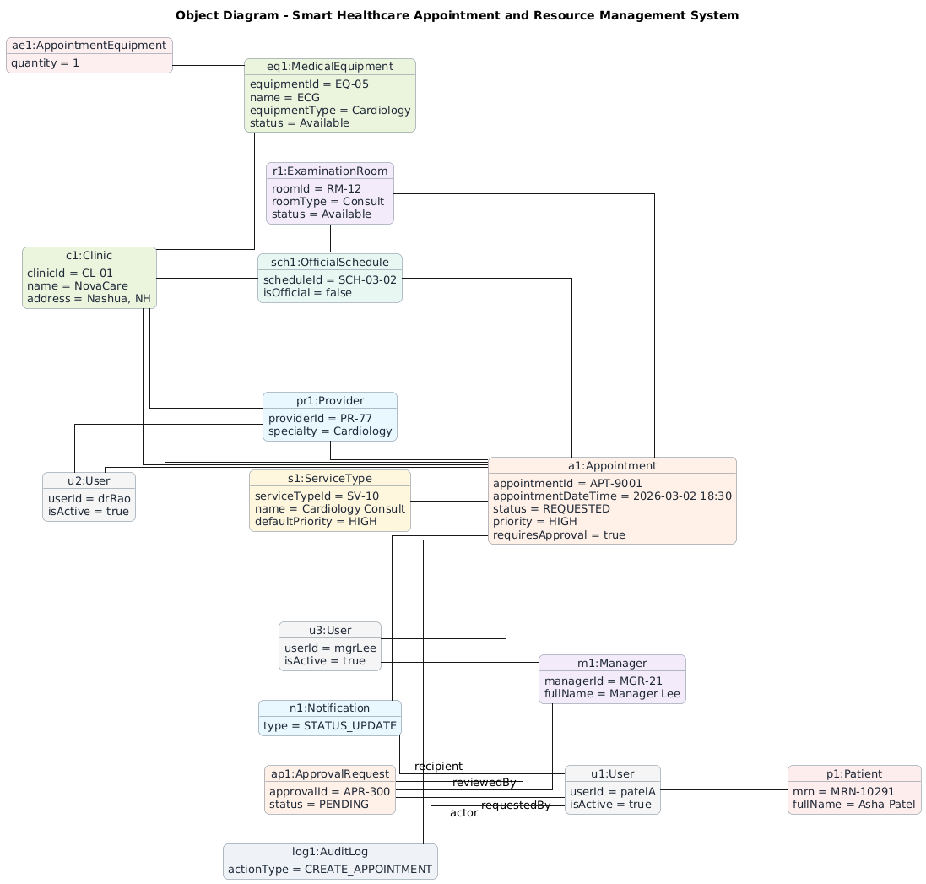
OBJECT DIAGRAM
This shows real example objects in my system at one time
Appointment is main object connected to all others
It includes patient, doctor, room, equipment details
Shows real values like ID, time, status, priority
Explains how all parts work together for one booking

Slide 13
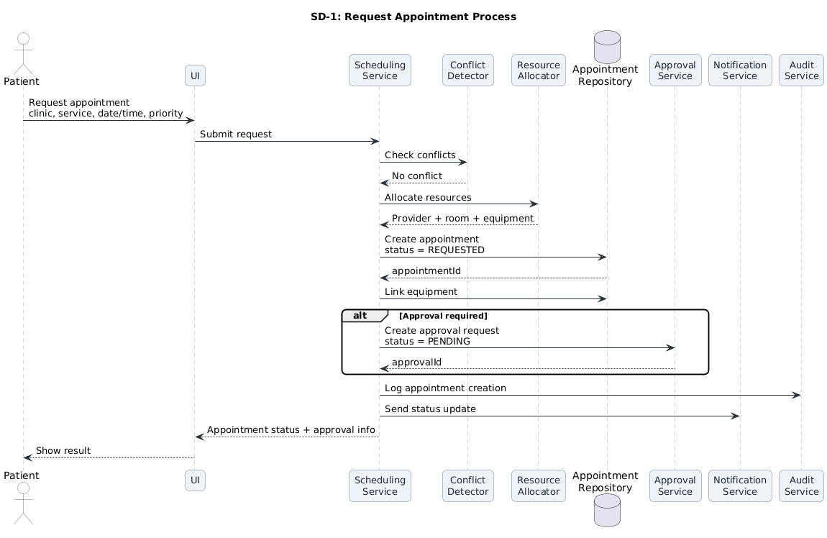
SEQUENCE DIAGRAM
This shows step by step how appointment request works in my system
Patient request goes to system, then system checks conflicts
System assigns doctor, room, and equipment
If needed, approval request is sent to manager
Finally, system saves data, sends notification, and updates result

Slide 14
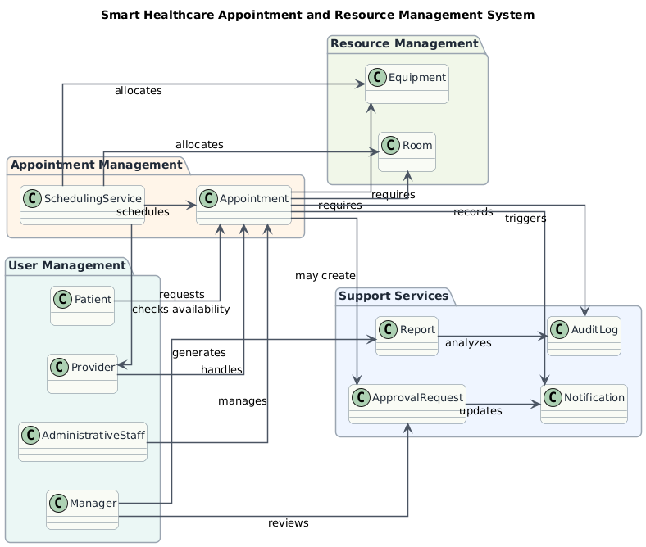
PACKAGE DIAGRAM
This shows how my system is divided into different parts
Appointment part handles booking and scheduling
User part shows roles like patient, provider, admin, manager
Resource part manages room and equipment
Support part handles approval, reports, notifications, logs

Slide 15
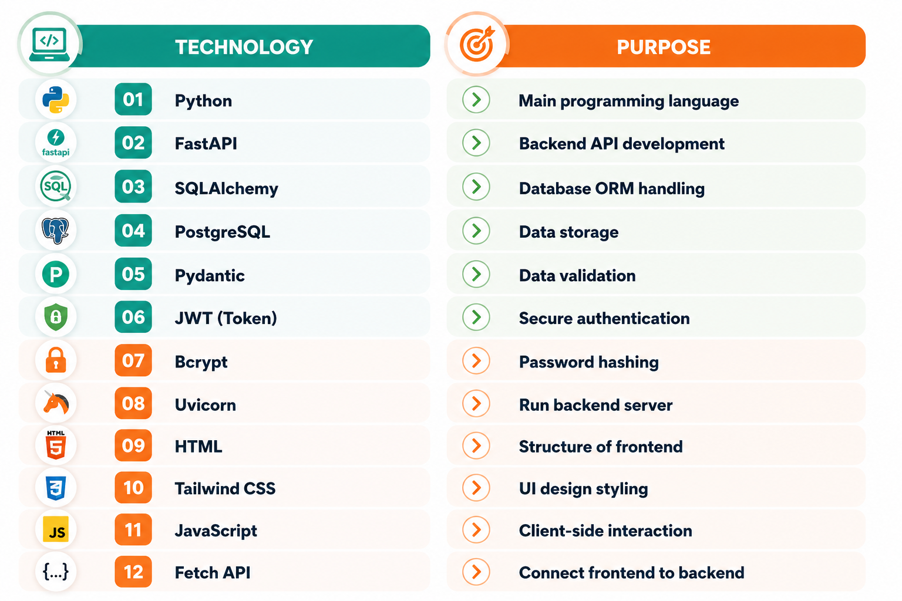
TECHNOLOGY STACK

Slide 16
CODE STRUCTURE
Folder/File | Purpose
app.py | Starts system and connects modules
database/db.py | Database connection
database/models.py | Defines system tables
schemas/schema.py | Data validation structure
services/auth.py | Authentication and security
services/service.py | Core system logic
routers/auth_route.py | Login and register APIs
routers/patients.py | Patient operations
routers/providers.py | Provider operations
routers/admin.py | Admin functionalities
routers/managers.py | Manager approvals and reports
templates/index.html | User interface dashboard

Slide 17
HOW CODE MEET USER REQUIREMENTS
User Requirement | Backend Implementation (Files & Methods) | Frontend Implementation
Patient books appointment | routers/patients.py function request_appointment uses AppointmentService.allocate_resources | Booking form submits data from dashboard
View available slots | routers/patients.py function get_available_slots uses AppointmentService.get_available_slots | Slot options shown in booking screen
Reschedule appointment | routers/patients.py function reschedule_appointment uses AppointmentService.validate_reschedule | User selects new date and submits form
Cancel appointment | routers/patients.py function cancel_appointment updates status to cancelled | Cancel button in My Appointments
Provider views schedule | routers/providers.py function get_my_schedule fetches appointment data | Schedule displayed in dashboard
Confirm or reject appointment | routers/providers.py functions confirm_appointment and reject_appointment | Accept and reject buttons in UI
Admin assigns room | routers/admin.py function assign_room uses check_room_availability | Admin selects room in dashboard
Manager approves appointment | routers/managers.py function approve updates status to confirmed | Approval screen for manager
Notifications sent | services/service.py function create_notification | Notification badge shown in UI

Slide 18
CLASS TO CODE MAPPING
Class (UML) | Code File & Implementation | Example Usage in System
User | database/models.py class User | Used in auth_route.py for login and role check
Patient | database/models.py class Patient | Used in patients.py for booking and profile
Provider | database/models.py class Provider | Used in providers.py for schedule handling
Appointment | database/models.py class Appointment | Used in all routers for booking and status
ServiceType | database/models.py class ServiceType | Used in booking to define duration
ExaminationRoom | database/models.py class ExaminationRoom | Used in admin.py for room assignment
MedicalEquipment | database/models.py class MedicalEquipment | Used in resource allocation logic
SchedulingService | services/service.py class AppointmentService | Used in booking, validation, allocation
Notification | database/models.py and service.py | Used in booking and approval alerts
AuditLog | database/models.py and service.py | Used in admin and manager actions

Slide 19
CONCLUSION
My system makes appointment booking simple and fast for users
It avoids conflicts by checking doctor, room, and equipment properly
It supports all roles with clear responsibilities in one platform
It improves clinic efficiency and reduces manual work
Overall, my system gives a complete smart solution for healthcare scheduling

Slide 20
REFERENCES
Bard, J. F., & Purnomo, H. W. (2005). Short-term nurse scheduling in response to daily fluctuations in supply and demand. Health Care Management Science, 8(4), 315–324.
Cao, Y., Liu, J., & Wang, G. (2020). Improving outpatient scheduling and reducing patient waiting time in healthcare systems. Journal of Medical Systems, 44(6), 1–12.
Dennis, A., Wixom, B. H., & Tegarden, D. (2020). Systems analysis and design: An object-oriented approach with UML (6th ed.). Wiley.
Gupta, D., & Denton, B. (2008). Appointment scheduling in health care: Challenges and opportunities. IIE Transactions, 40(9), 800–819. https://doi.org/10.1080/07408170802165880
Pressman, R. S., & Maxim, B. R. (2020). Software engineering: A practitioner’s approach (9th ed.). McGraw-Hill.
Zhu, Y., Qin, L., He, B., & Xin, D. (2022). Design and implementation of laboratory appointment management system based on RFID. In Proceedings of the 2022 International Conference on Information System, Computing and Educational Technology (ICISCET). IEEE. https://www.computer.org/csdl/proceedings-article/iciscet/2022/604400a288/1HbbSBfA532

Slide 21

Thank you
SRAVAN KUMAR REDDY PERUGU
sperugu@rivier.edu

